Slide 1
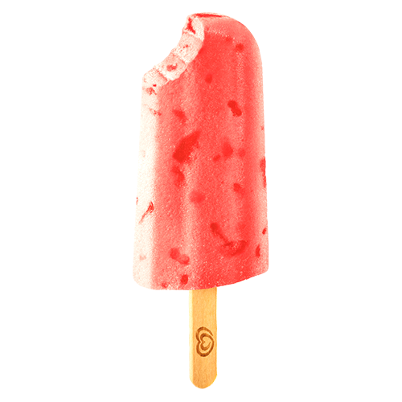


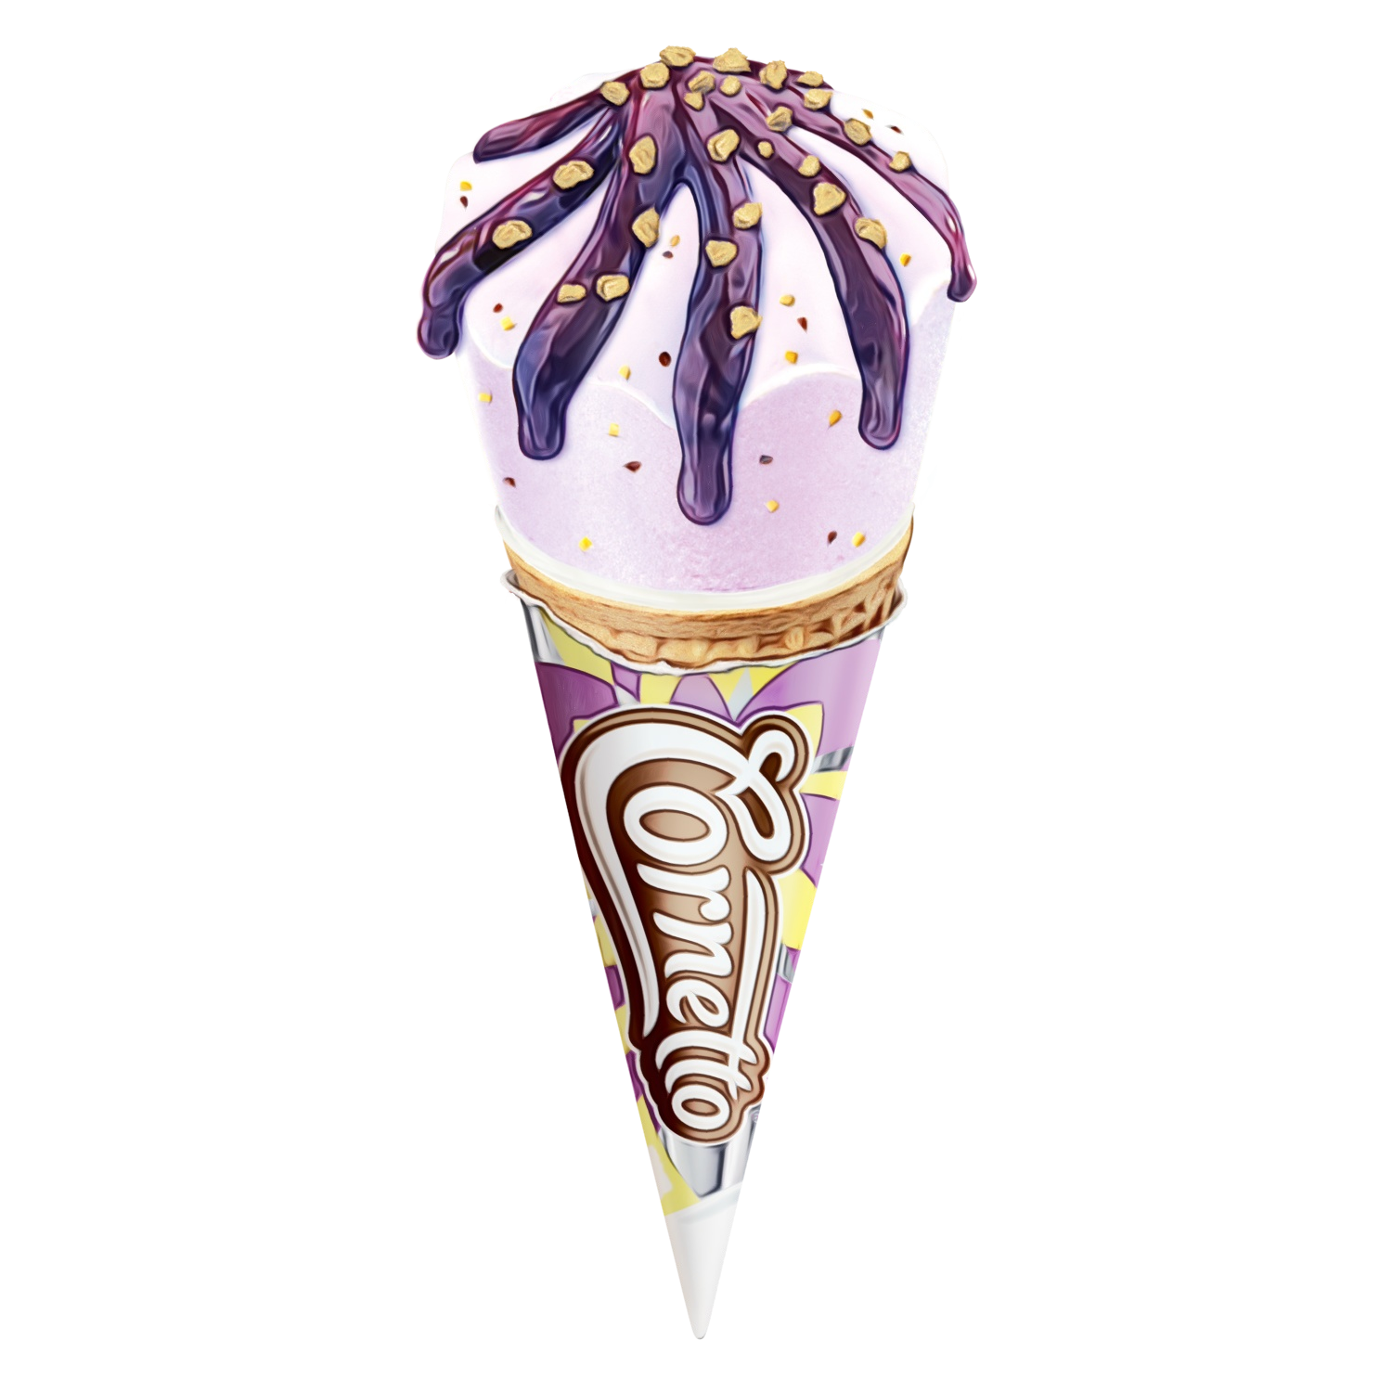
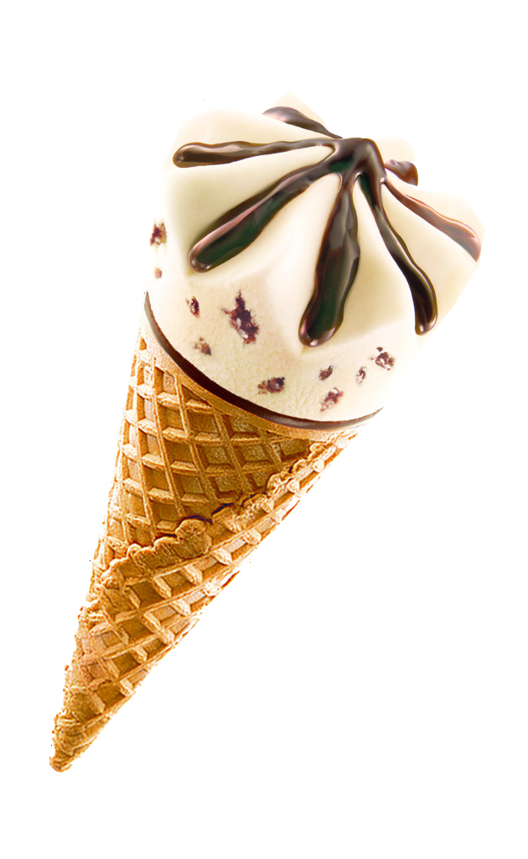
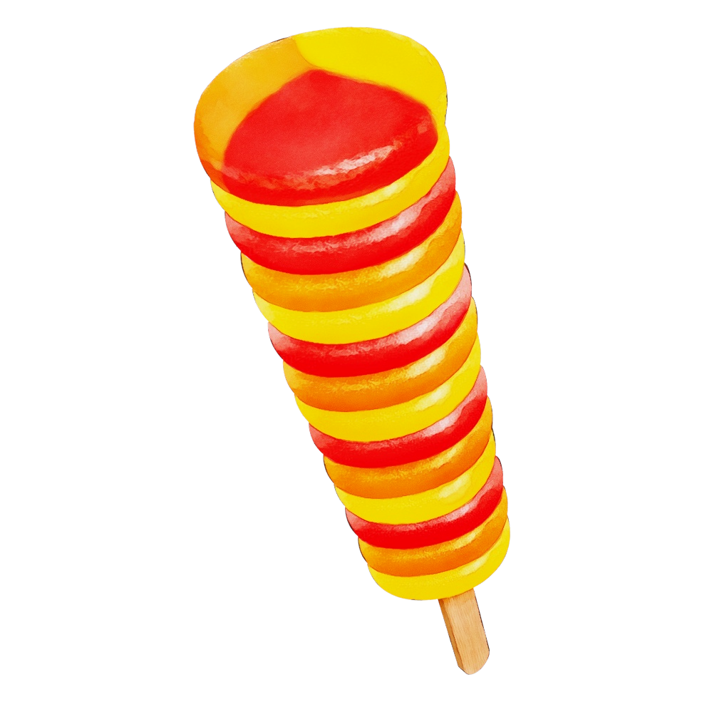
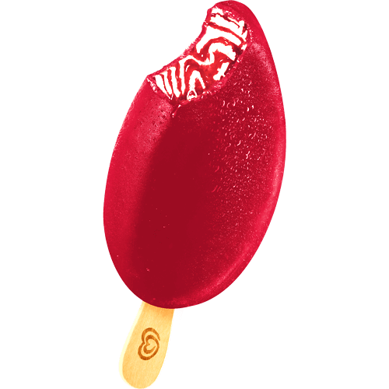
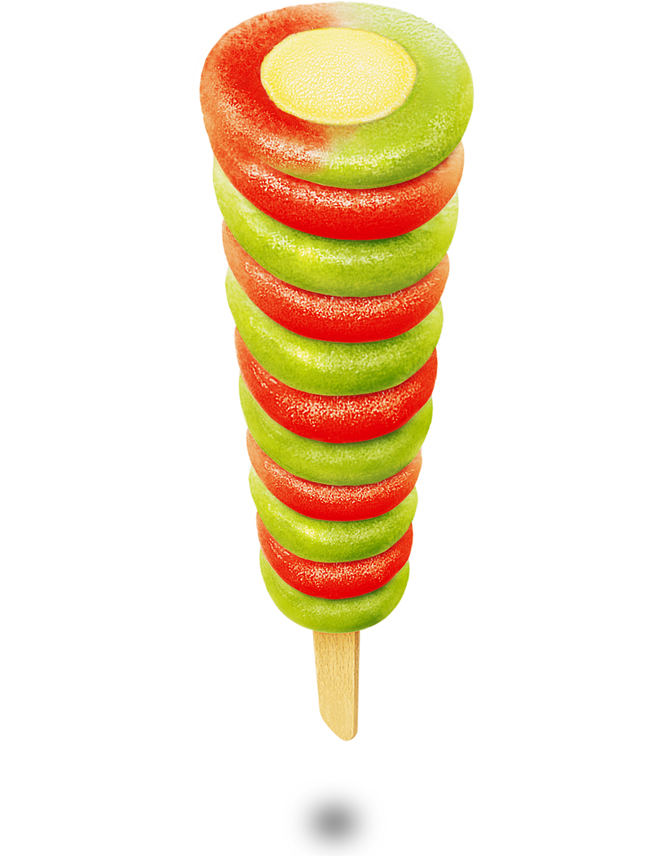

Unilever Marketing
Dashboard
Stacy Lai

Slide 2
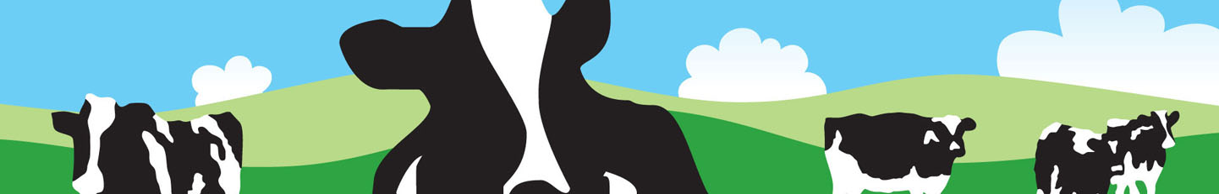

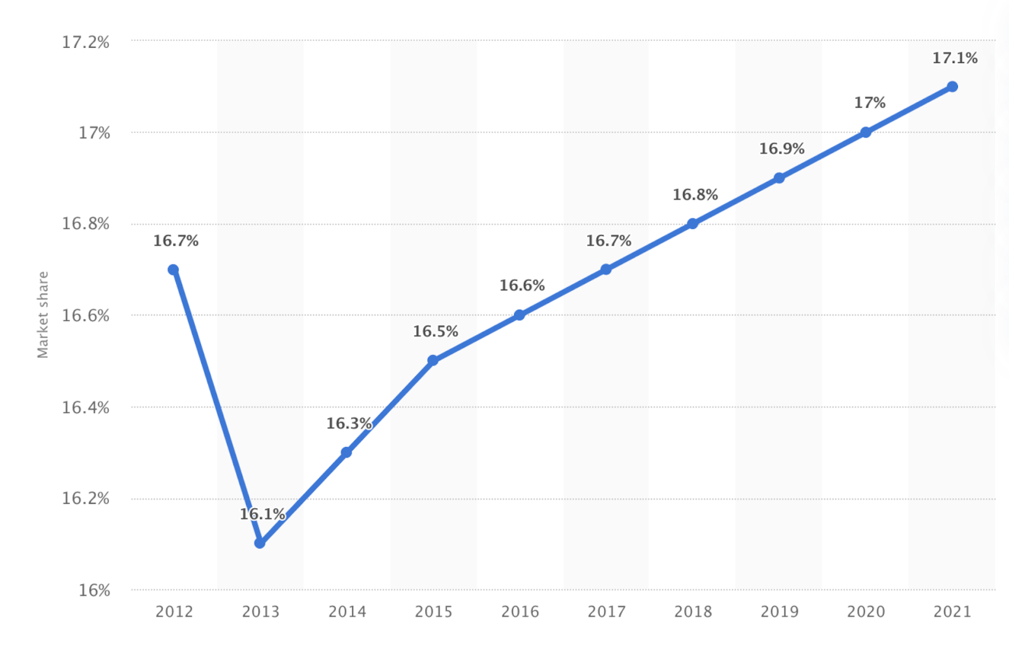


Data Creation:Cleaning, Normalization, ETL
Food
Ice
Cream
Personal Care
Unilever’s ice cream market share worldwide from 2012-2021
Notes:
Why ice cream
Data transformation..(aggregation/price/interesting finding)
Why ETL these tables.. How they connect (diagram)

Slide 3

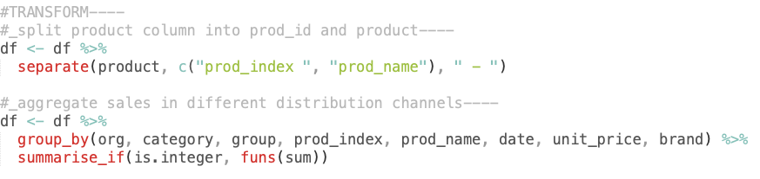
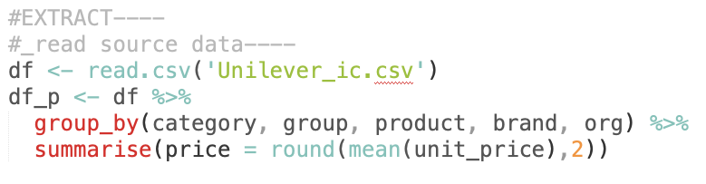
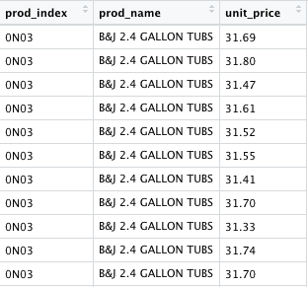
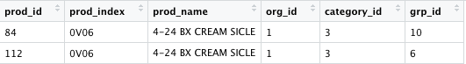
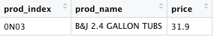
DATA EXTRACT AND TRANSFORM

Slide 4
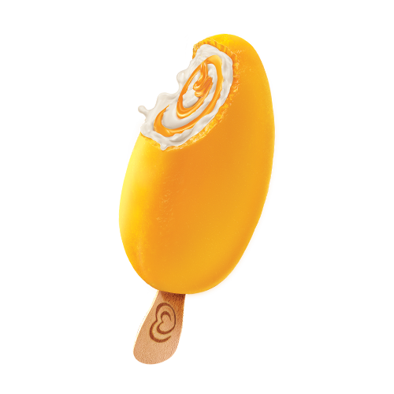
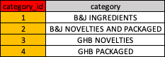
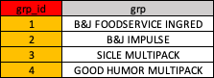
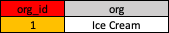
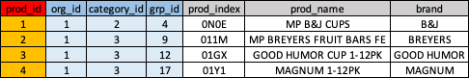
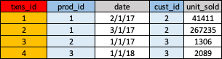
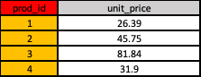
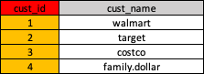
TABLE NORMALIZATION
Organization table
Primary Key
Category table
Primary Key
Group table
Primary Key
Primary Key
Foreign key
Products table
Primary Key
Foreign Key
Foreign Key
Primary Key
Txns table
Price table
Primary Key
Custs table

Slide 5
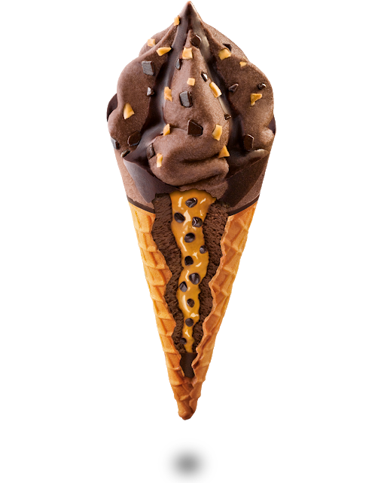
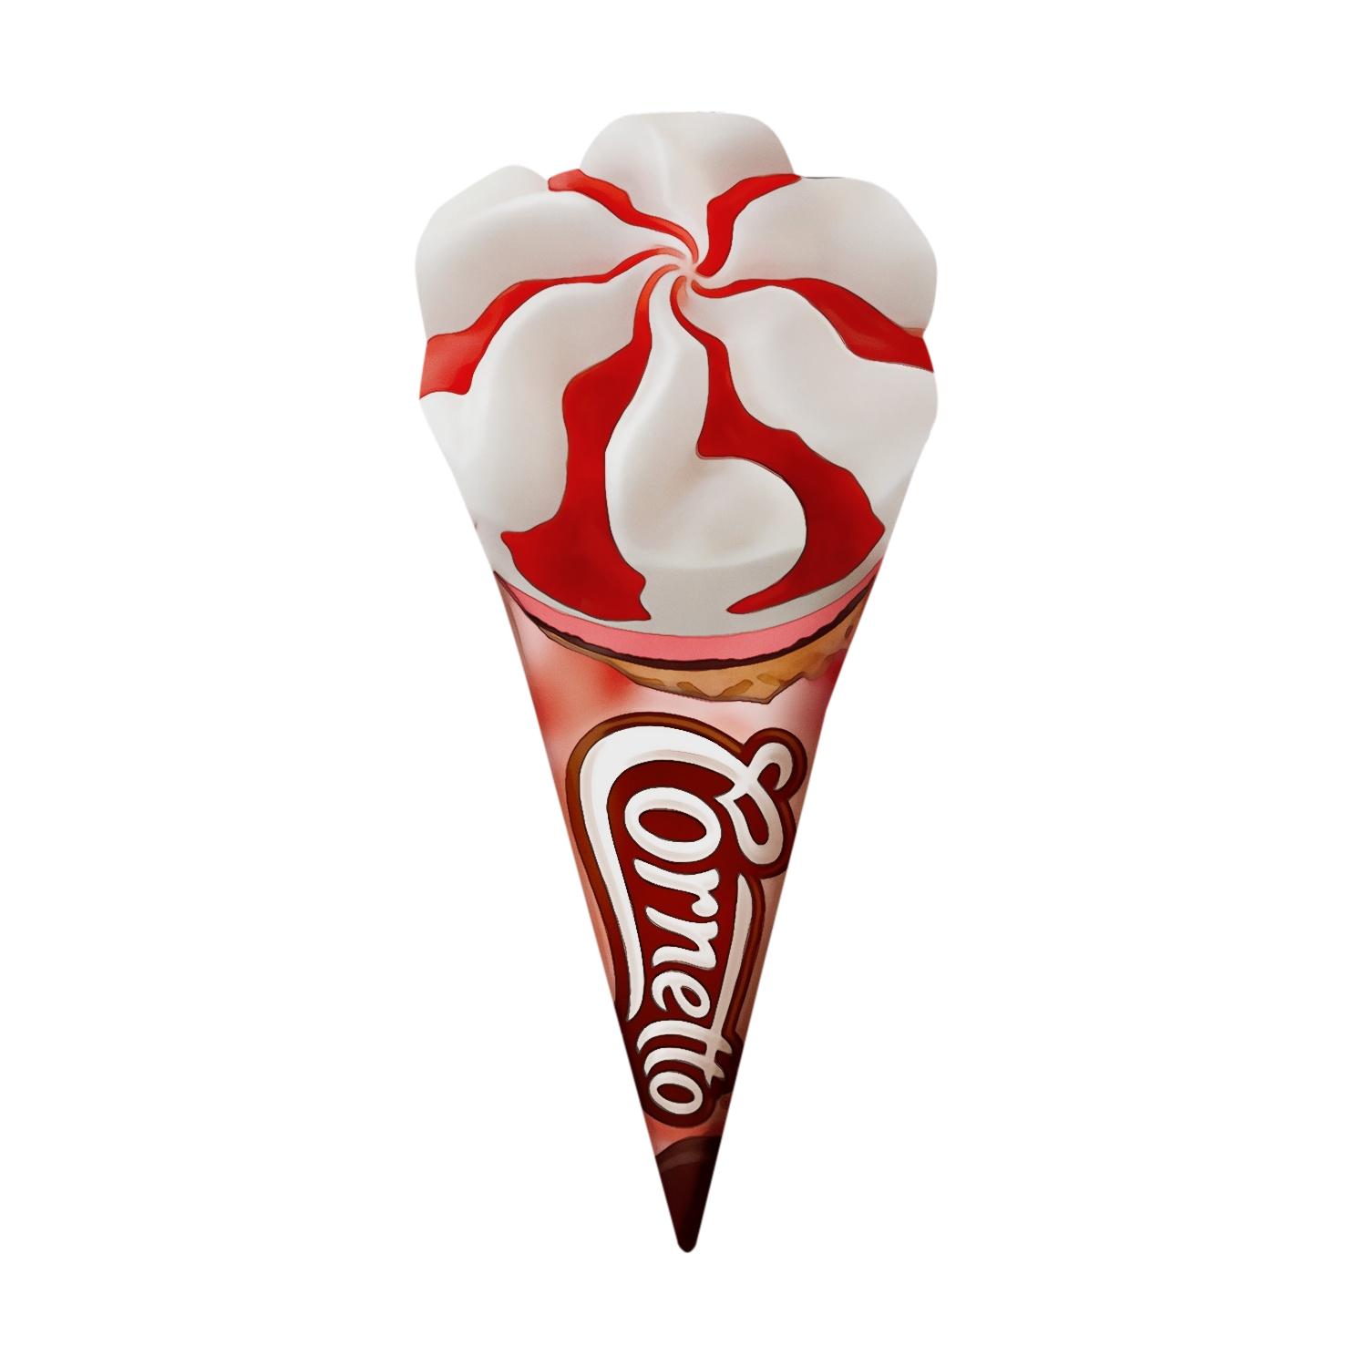
Hello
Shiny App
Sales Ranking
What are the best sellers?
What are the top customers?
What is the best price range?
Demand Planning:
How many ice cream need to be made in the future in order to improve inventory turnover?
Logistics:
Where is the best location for Walmart distribution center?
https://xl2944.shinyapps.io/Unilever/
Notes:
For our analysis parts, we conduct several projects which focus on sales ranking, demand planning and logistics. For sales ranking part, we wanna figure out the best sellers, the top customers as ell as the best price, range. For Demand planning part, we use part sales data the predict how many ice cream need to be made in the future in order to improve the inventory turnover. finanlly , we also aim to determine the best location for walmart distribution center. My teammates ganna cover these problems specifically in our shiny app next.

Slide 6
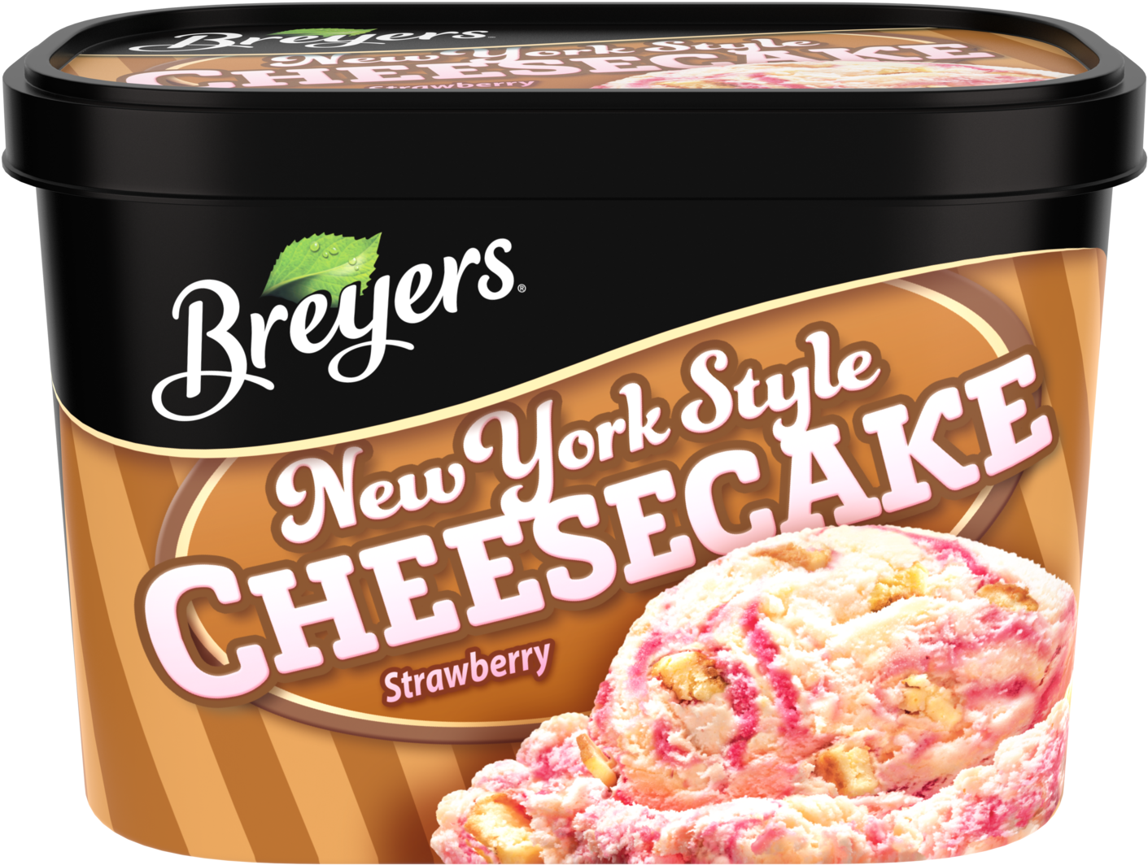
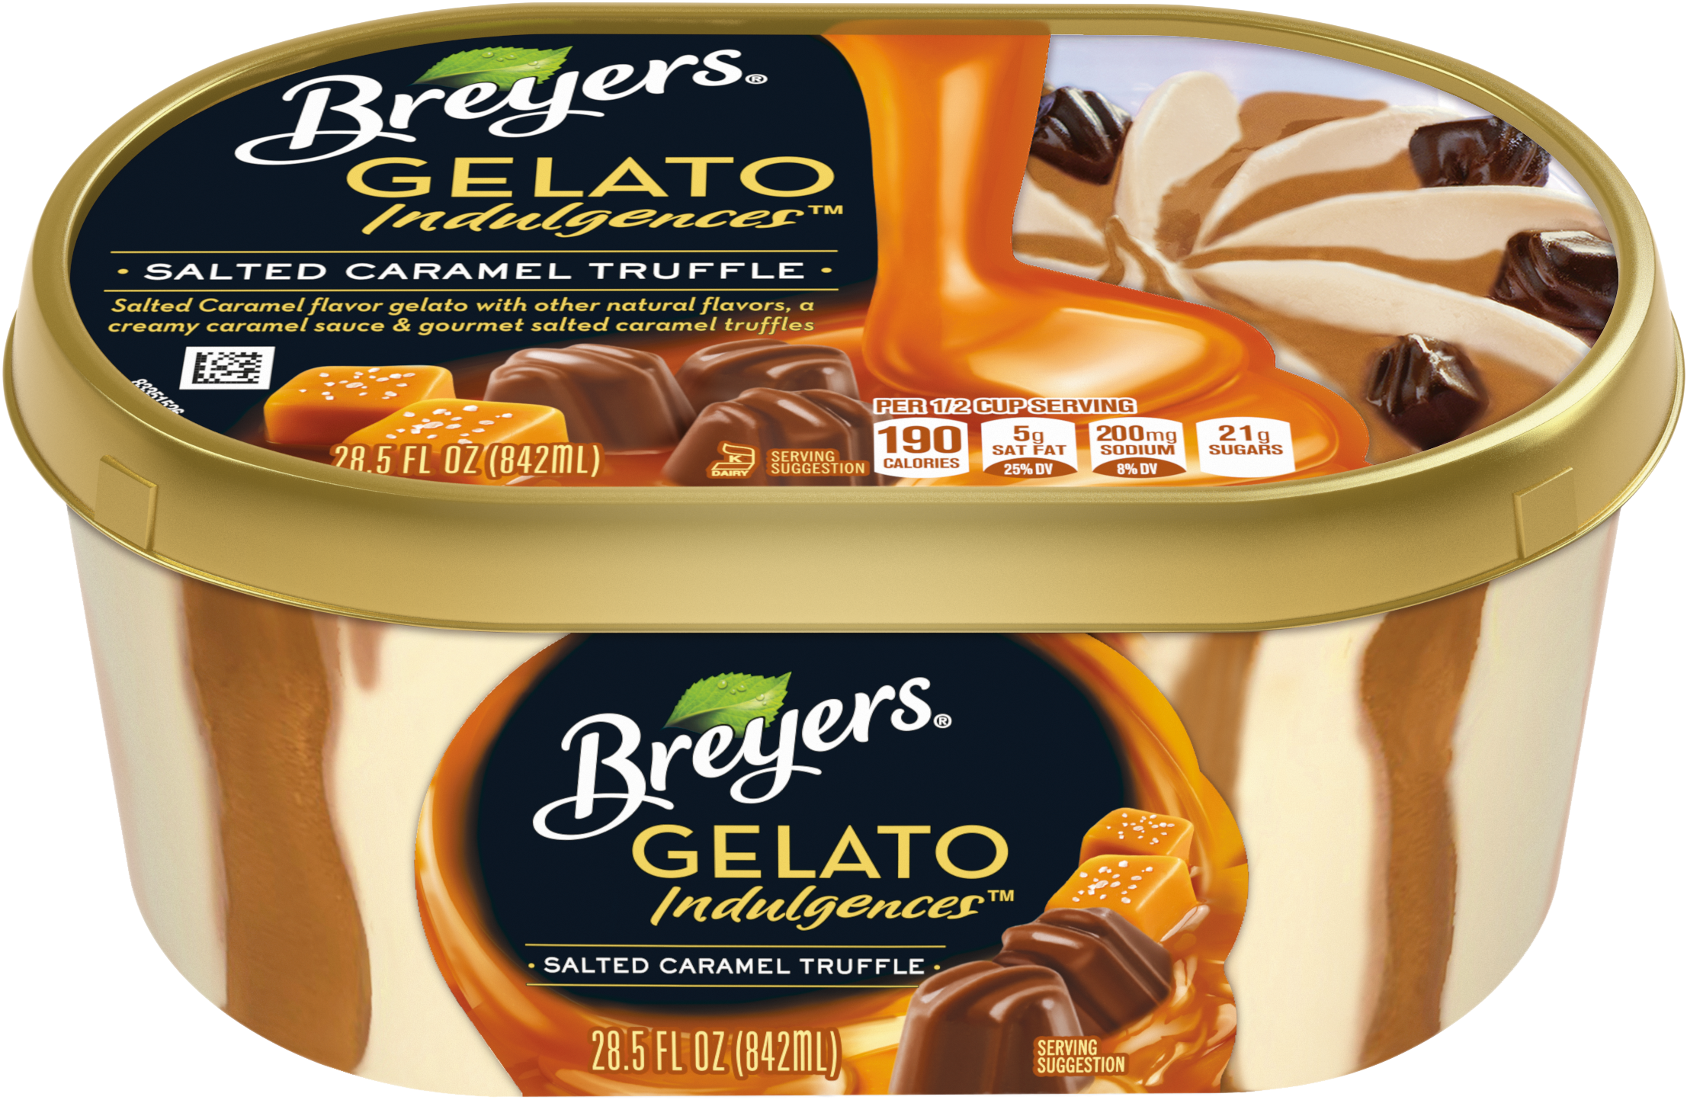
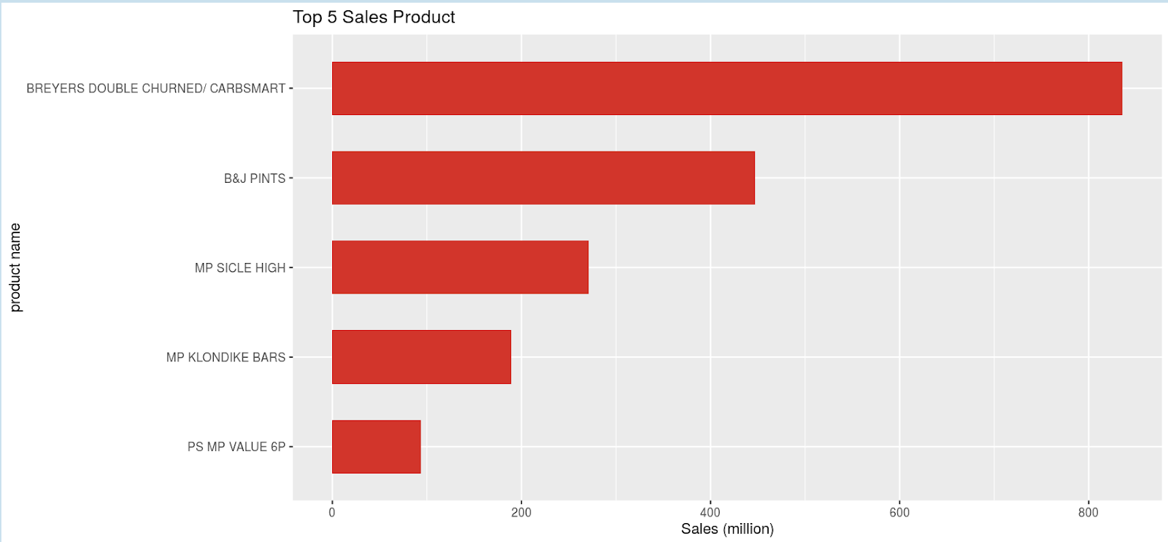
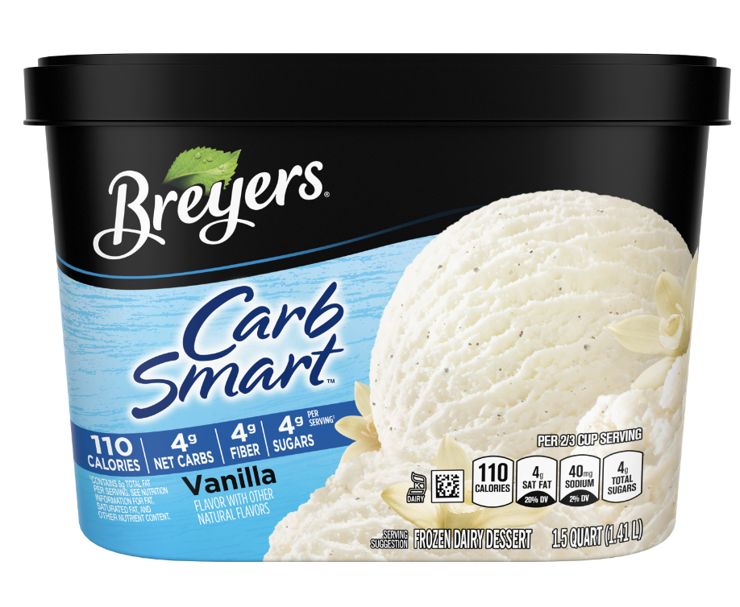
1 - Top Products of Ice Cream
No.1 -- BREYERS DOUBLE CHURNED/ CARBSMART
835.6 million of sales
Notes:
1. Top Products of Ice Cream
The first analytical question is tightly related to the sales ranking under the range of ice cream produced by Unilever. To be more specific, what is the sales ranking by products of ice cream based on the total quantity sold from year 2017 to 2019? In other words, we are targeting at the top 10 ice cream products in the market. From the analysis, we could see the top one product is the brand Breyers, typically of double churned or carb smart, which is the ice cream producing with extra processes that it contains less calories, less net carbs, less sugar, but higher fiber per serving. We can learn from it, more customers are intended to live healthier.
If you cannot give up the sweet and creamy ice-cream, look for an alternative to ice cream offering less carbs. The second is Ben & Jerry with pint-sized packages. It is obvious that, pint is more popular size for ice cream lovers, instead of quart or other sizes. The following popular products are from popsicle, Klonodike and Magnum. By analyzing the top products of ice cream, Unilever could better acknowledge the proportionality in production process, which brand, flavors or package sizes should be highly produced and sold to retailers.
Next, Sandy would illustrate more findings focusing on the part of retailers.

Slide 7

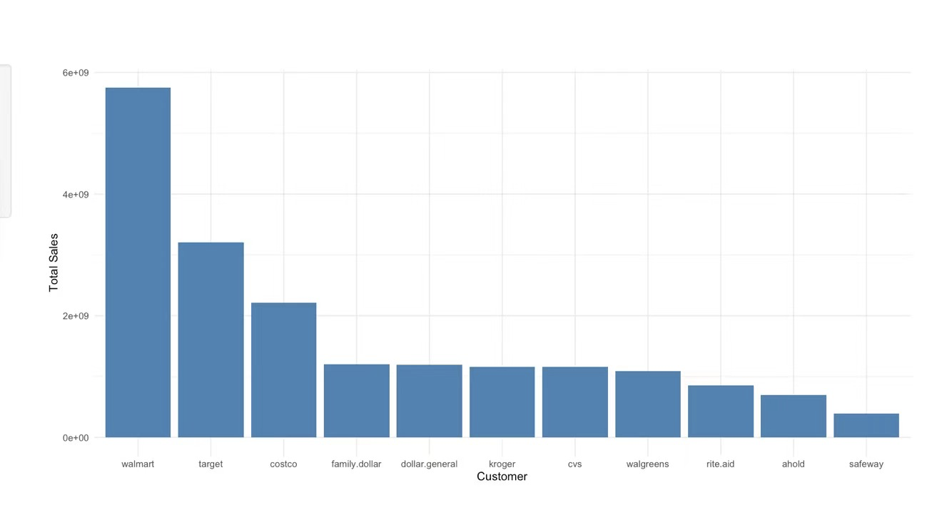
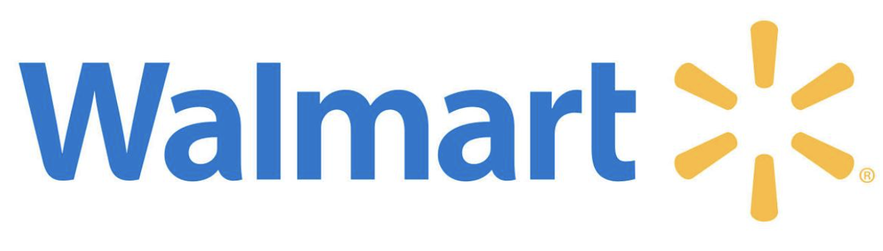
2 - Top Retailers of Ice Cream
No.1--Walmart
820 million dollars of sales
17 billion dollars of 3-year total revenue
Notes:
Next, my group mates will analyze from demand planning aspect.

Slide 8
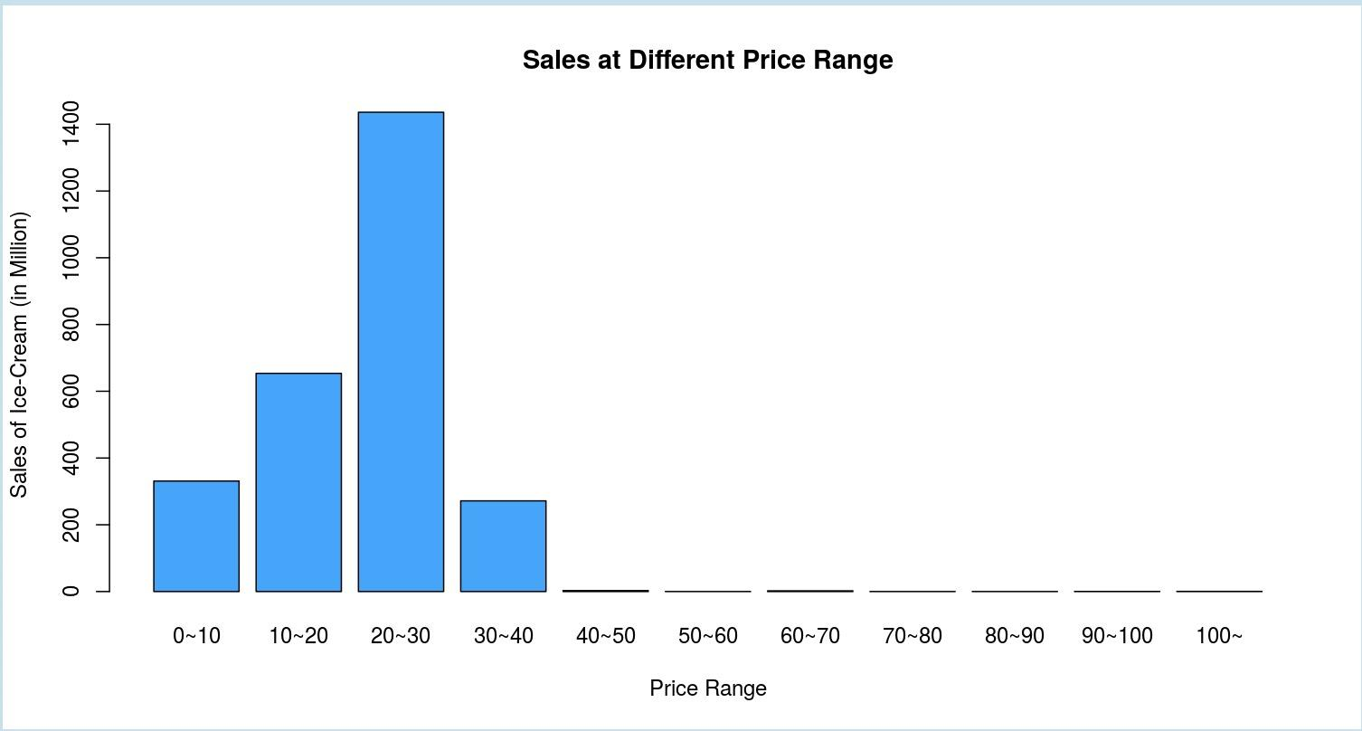
3 - Price Range
No.1 -- $20~30 (143.6 million of sales)
Mainly under $40
Notes:
Unilever sells ice cream for a wide range of prices, from the cheapest $0.01 BREYERS Test pallet to the most expensive $3270.33 KLONDIKE Mixed Pallet. Therefore, we want to figure out Which price range has the highest sales volume. On this page, we can select years and retailers to see the difference between the sales and price range. From the results, we can find most of the products they sold are under $40, and 20 to 30 dollars ice-cream occupy a huge market share from 2017 to 2019, and in different retailers, the sales contribution of the different price range is similar. Therefore, Customers are most likely to accept products within 20 to 30 dollars. In the future, if the company wants to sell a new ice cream targeted the mass market, and we think the best price for this product is between 20 to 30.
Next, my group mates will analyze from demand planning aspect.

Slide 9
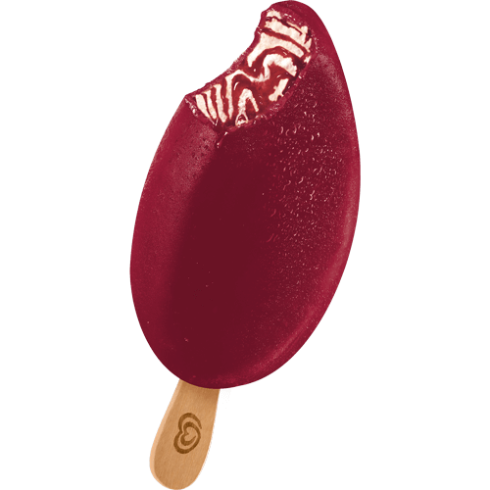
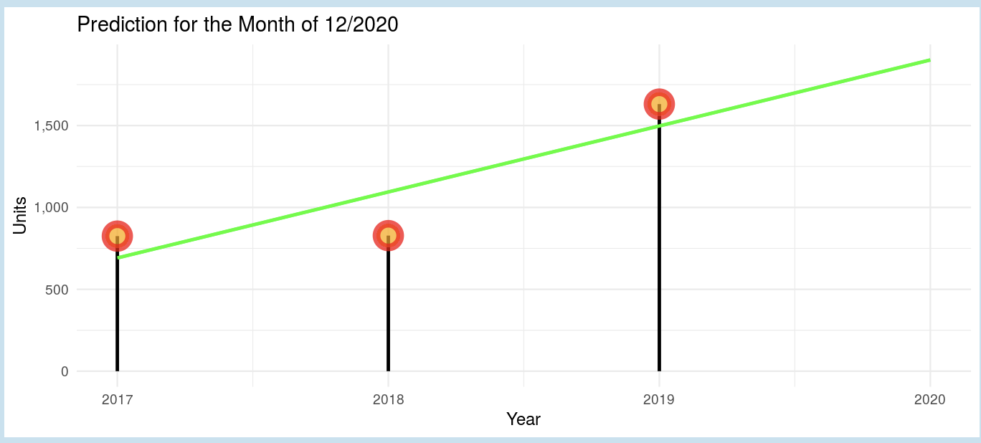
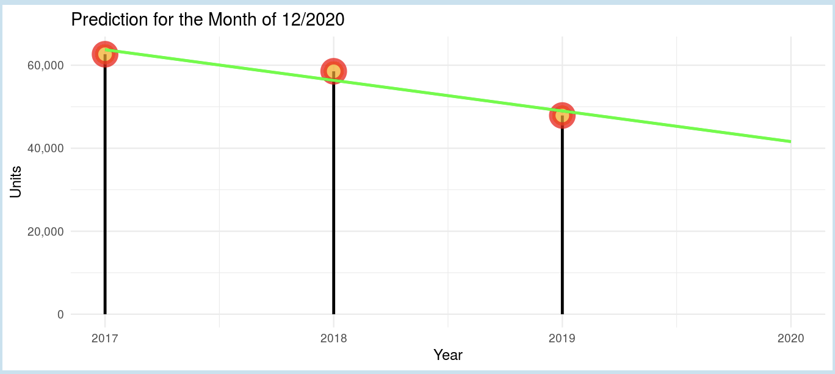
4 - Demand Prediction
Product: B&J 4-1 GALLON
Demand prediction for walmart in Dec.2020
Product: B&J 2.4 GALLON TUBS
Demand prediction for walmart in Dec.2020
Goals: How many ice cream need to be made in the future in order to improve inventory turnover?
Notes:
This page is meant for demand planning. It shows all units sold by month, product, and retailer in 2017, 2018, 2019.
Users could select a specific retailer, product and month from the drop down menu on the left panel. For the product, users could also type the names in for better efficiency. The picture on the right hand side will change with different retailer-selected on the left.
These 3 variables will generate the chart down below, which shows a rough prediction of the demand of a certain product to a certain retailer in a specific month. From this chart, we can see that the demand for this product shows a upward trend, and based on these 3 years past performance, the chart predicts Walmart would order roughly 2000 units of this product. This will give us a general picture of How many ice cream need to be made and plan acordingly.
Value:
This will be very helpful for our demand planning, supply buyer, and manufacture department as it will give us a good grasp of the overall trend and the amount of ice cream need to be make in the future in order to minimize unnecessary inventory as low as possible.

Slide 10
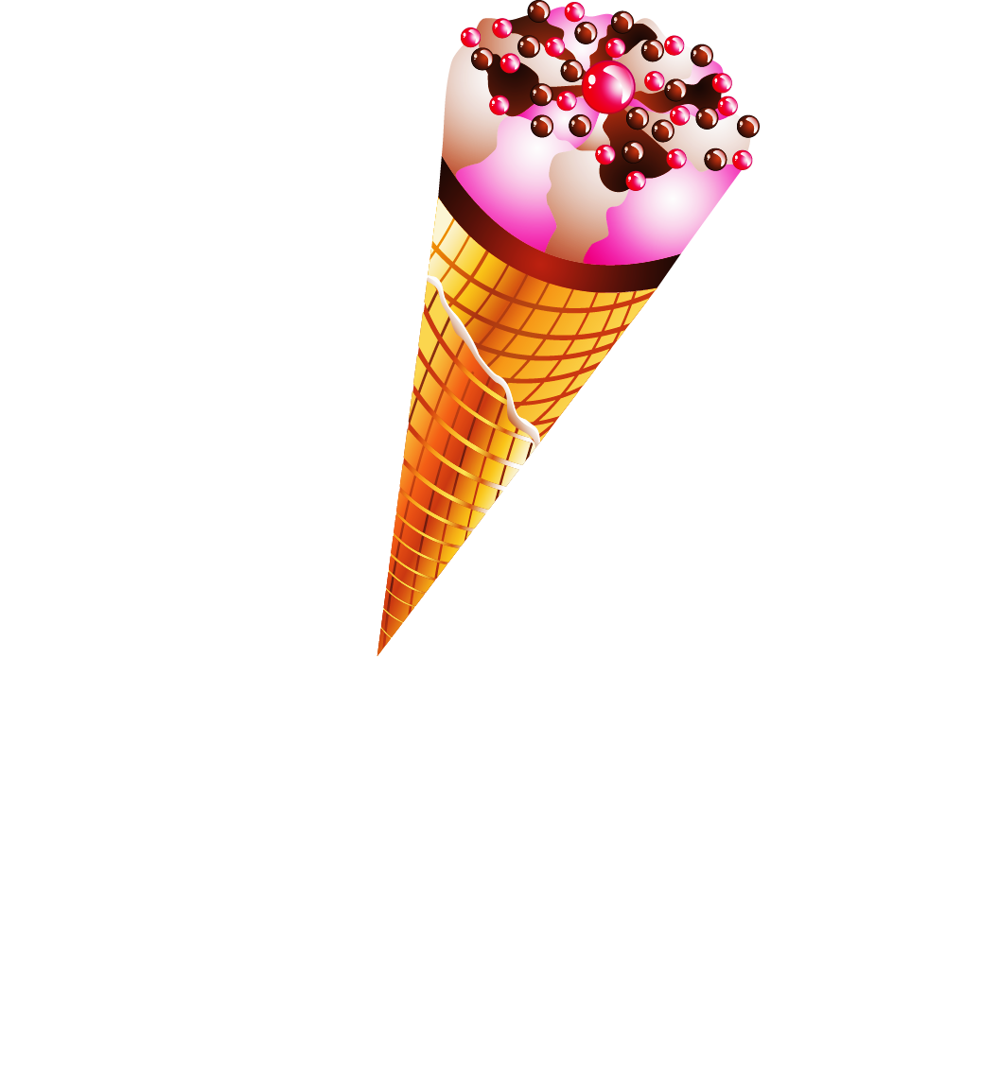
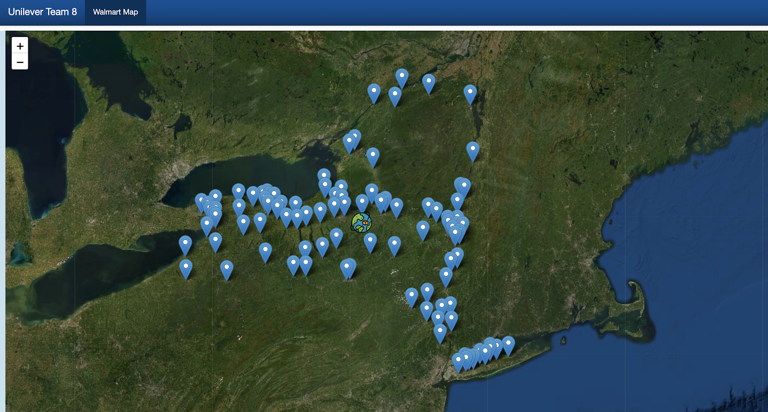
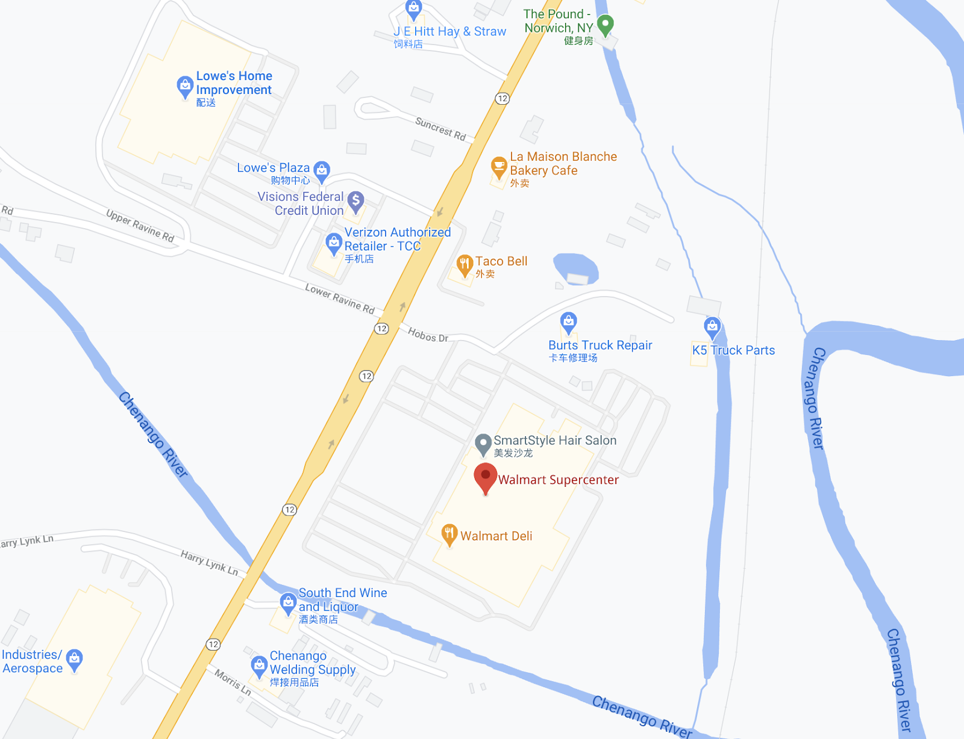
5 - Map
Closest Walmart supercenter Address:
5396 NY-12, Norwich, NY 13815
Notes:
The last insight we have solved a logistics problem for Unilever. Based on the retailer analysis from my teammate, we found out Walmart is our largest customer in past three years, so we are interested in learning where is the best location for walmart distribution center in New York, which helps minimize the distribution distance, and delivery cost for Unilever Ice cream. Using lng/lat data of all the store location in New york, we created a store map and calculated the center location of all walmart stores. We found out the best location for walmart dist. Center should be at 5396 NY-12, Norwich.
And this will be all of our presentation today. Thank you! Is there any question and comment?

